Slide 1
Multilingual Text Inversion Detection
By-
Ali Azam Kazmi
Aadit Trivedi
Arya Shah

Slide 2

Problem Definition
There can be problems in textual scanned images. The problem of inversion is one of the hardest anomaly to detect efficiently though it can be easily decipherable visually. Moreover, the scanned document can be in any language and the text can be anywhere in the image.

Slide 3


1. Abstract
It is common to have aberrations in manually scanned textual documents. Document inversion is among the most frequent but a harder anomaly to detect efficiently. Moreover, an algorithm that may detect text inversion in one language may not work for another language.
Deep Learning can be a language-agnostic solution, but they are not the most efficient. In this paper, we present an inversion detection algorithm based on shape context, which is a mathematical descriptor that uses log-polar histograms to encode relative shape information.

Slide 4
Furthermore, to localize text blocks inside images, an efficient text bounding box algorithm has been proposed.
The end-to-end algorithmic pipeline can localize text and detect inversion in multi-lingual text documents.

Slide 5
The experiments demonstrate the method to have around 17.5x speed improvement vis-a-vis a standard Deep Learning model, with near 100% accuracy on the test dataset.

Slide 6
In this project, an algorithm to efficiently localize text has been implemented. Once the text area in an image is localized, it is passed on to language identification algorithm. Further, a mathematical descriptor is used to identify the text is inverted or not. The entire pipeline uses traditional methods in place of deep learning based methods and hence much more efficient.

Slide 7
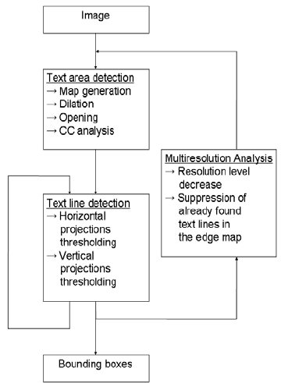
Flowchart:

Slide 8
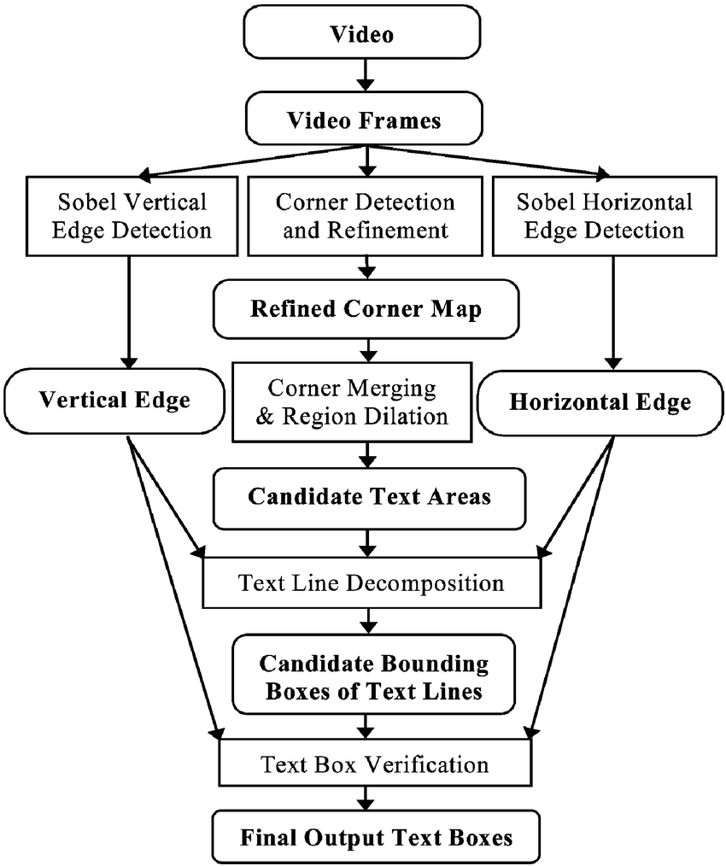
Flowchart of Text Detection

Slide 9
Thank you!

